Slide 1
An Analysis of Airbnb Attributes in Different US Cities
John Phillips
August 2024

Slide 2
Project Overview
Motivation: Summer is in full swing, which means many people nationwide are traveling. Since people are always looking for a bargain, let’s see if there are any useful insights found in the various Airbnb cities.
Agenda: attempt to discern useful attributes that can guide customer behavior by uncovering:
The most affordable places
The best bargains
The best type of room
Which cities have the most availability
And other useful insights

Slide 3
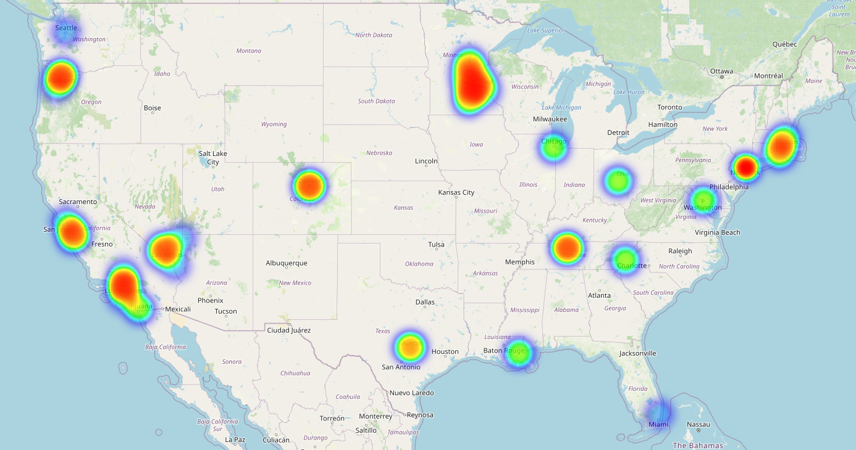
Where is the data coming from?
Data collected comes from 27 different US cities and counties across the country.

Slide 4
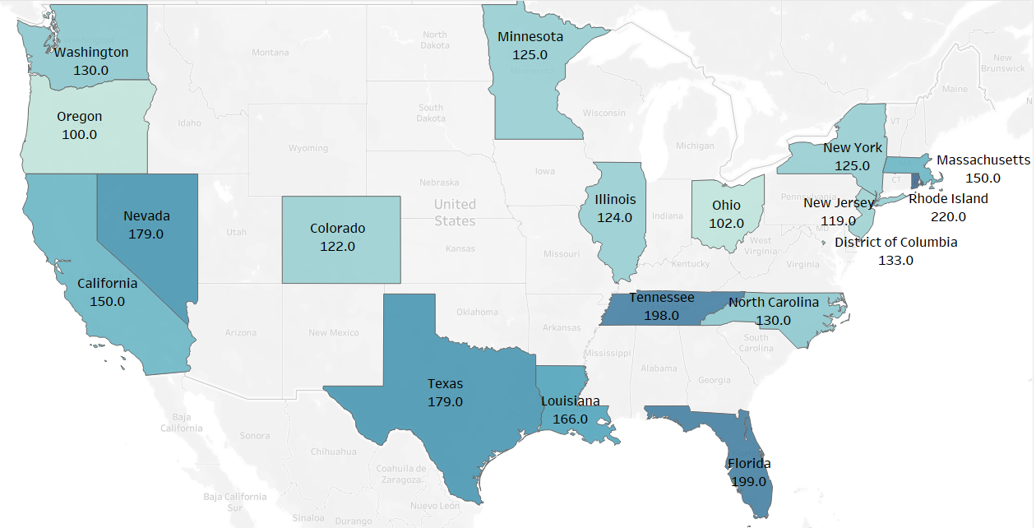
State by state comparison
This shows all states contained in the dataset
The darker the state, the higher the median price for an overnight stay.
Rhode Island, Florida, and Tennessee have the highest median prices.
Oregon, Ohio, and New Jersey have the lowest median prices.

Slide 5
Let’s look at some basic stats:
room_type | average_price | median_price | min_price | max_price | std_price
Entire home/apt | $282 | $177 | $1 | $100,000 | $871
Hotel room | $740 | $240 | $0 | $10,000 | $1,228
Private room | $192 | $75 | $0 | $100,000 | $1,366
Shared room | $99 | $42 | $11 | $10,000 | $457
As you can see, there is quite a bit of variation: some rooms go for as cheap as nothing (perhaps an error?), or up to $100 grand.
I’d say for a space-to-price ratio, the best option on this list is the “entire home/apt” which only has a median value of $177/night.

Slide 6
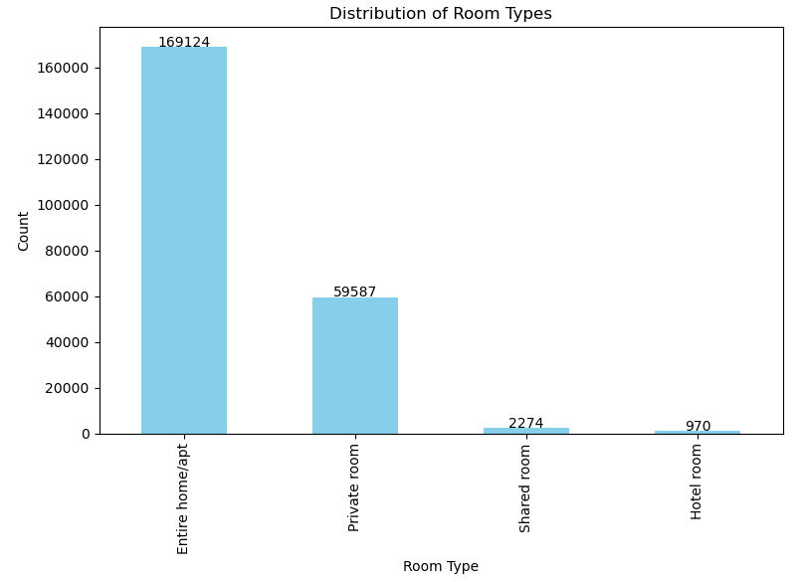
What room type is most typical?
The vast majority, 73%, of the units offered are “Entire room/apt”

Slide 7
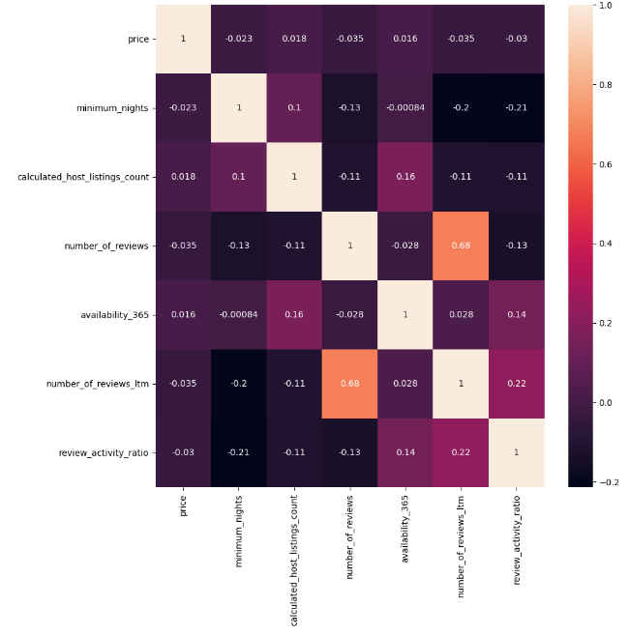
Are there any strong relationships between the different attributes?
The darker the square, the weaker the relationship.
This shows us there is almost no relationship between any of the variables
The only one with a strong relationship is the “number of reviews (ever)” and the “number of reviews in the last 12 months”

Slide 8
Customer Behavior by City
rank | city | review_activity_ratio
1 | Columbus | 0.602
2 | Salem | 0.527
3 | Broward County | 0.513
4 | Nashville | 0.480
5 | Clark County | 0.477
6 | San Diego | 0.442
7 | Denver | 0.438
8 | Twin Cities MSA | 0.437
9 | Seattle | 0.436
10 | Chicago | 0.434
The review-to-activity ratio was created from two variables: how many reviews were left in the past year, versus the number of reviews all-time.
Using this as a proxy for customer activity, these are the top 10 cities/counties by review-to-activity ratio.
Why do people leave reviews? Usually, it’s because they either loved their stay, or hated it.
Regardless, more recent reviews being left equals more overall activity in a given area.

Slide 9
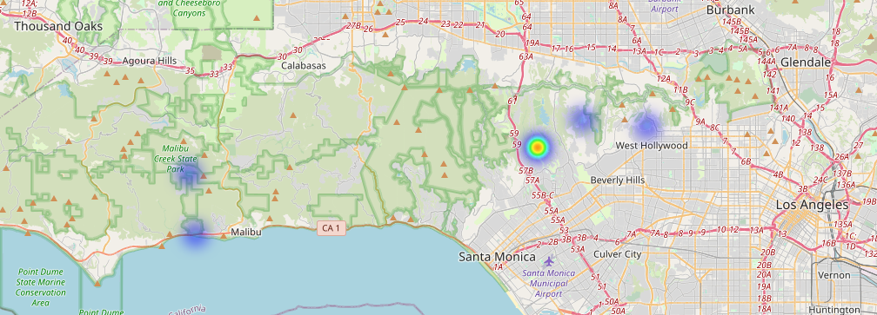
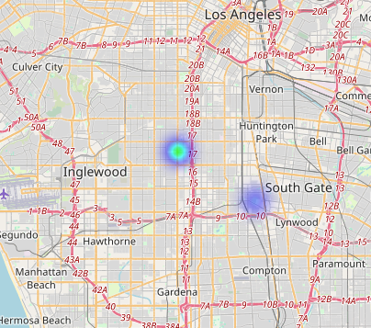
Los Angeles: A Polarizing City
LA is home to some of the most expensive neighborhoods (above) and some of the cheapest neighborhoods (left) in this entire dataset
If you want to get the LA experience on a budget, consider looking at neighborhoods a bit farther south of the city (South Gate or Inglewood), rather than the more popular Hollywood/Beverly Hills/Malibu locations

Slide 10
Which cities are most available? The least?
rank | city or county | mean_availability
1 | Broward County | 220
2 | Columbus | 208
3 | Nashville | 207
4 | Asheville | 204
5 | Chicago | 202
6 | Los Angeles | 200
7 | Boston | 200
8 | Jersey City | 198
9 | Salem | 196
10 | Pacific Grove | 194
rank | city or county | mean_availability
18 | Santa Cruz County | 179
19 | New Orleans | 176
20 | Oakland | 174
21 | Denver | 173
22 | Washington D.C. | 172
23 | San Francisco | 170
24 | Cambridge | 168
25 | Rhode Island | 161
26 | Austin | 152
27 | New York City | 140
To the left, these cities are the most available, on average, throughout the year.
On the right, we see the least available cities.
What does this tell us? Owners of the Airbnb’s in the right-hand chart tend to covet their properties more, perhaps because of good location, desirability, they’re less financially dependent on the property, or some other reason.

Slide 11
What descriptions are associated with higher prices?
keyword | count | avg_price
suiteness | 126 | $ 7,460.00
888 | 287 | $ 1,737.00
palace | 197 | $ 1,675.00
court | 155 | $ 1,610.00
plus | 151 | $ 1,586.00
suites | 727 | $ 1,576.00
compound | 108 | $ 1,417.00
estate | 541 | $ 1,346.00
malibu | 465 | $ 1,138.00
resorts | 126 | $ 1,132.00
A lot of these words make sense
If you’re staying in an estate, a compound, a palace, or a resort, that’s going to be pricier.
Now, whether or not these types of descriptions always lead to a higher quality stay is another story.
And these descriptions may not accurately depict the unit.
Sometimes, people will look for any way to boost their prices.

Slide 12
What descriptions are associated with lower prices?
keyword | count | avg_price
couch | 119 | $ 86.42
bunk | 253 | $ 84.35
shared | 1921 | $ 79.73
fridge | 132 | $ 79.55
unfurnished | 133 | $ 68.84
closet | 170 | $ 68.25
hostel | 284 | $ 68.01
dorm | 210 | $ 65.53
female | 243 | $ 54.29
hdtv | 174 | $ 44.02
Again, a lot of these words make sense.
Words like shared, unfurnished, hostel, dorm, or closet will lead one to think the unit is a little short on amenities.
As to why HDTV, female, or fridge are on this list is a mystery.
Searching for descriptors like these can help a bargain-seeking traveler save a little money.

Slide 13
What about Airbnb hosts?
city | number_of_hosts | average_listings_per_host
Boston | 1268 | 192
Chicago | 3590 | 138
Santa Clara County | 2824 | 134
Los Angeles | 21242 | 113
Cambridge | 375 | 84
Clark County | 5483 | 82
Seattle | 3368 | 71
Nashville | 3702 | 61
Washington D.C. | 3364 | 55
Broward County | 6927 | 45
Here are the top 10 cities by average number of listings per host.
192 listings per host on average is a lot.
This high average is due to a small number of entities with a large numbers of listings.
The bottom chart reflects this point: one superhost has over 4300 listings!
This matters because a business developed around Airbnb units can mean higher quality, more standardization, and more consistency on a stay-to-stay basis.
host_name | unit_count
Blueground | 4303
Jino & Scott | 1003
Zeus | 906
RoomPicks | 748
Scott And Jino | 663
Landing | 597
Eugene | 394
RoomPicks By Victoria | 370
Suiteness | 365
LiveSuite.Io | 311

Slide 14
How is all this information helpful?
If you’re a bargain-hunter looking to maximize savings this summer, consider some of these take-home points:
Searching for units by keywords associated with low prices can help you find cheaper units.
Opting for a “private room” over an “entire room/apt” is another way to save money- as long as you don’t mind interacting with strangers.
Searching for units by superhost can help you find an experience that is more streamlined and consistent.
States like Oregon, Ohio, and New Jersey will offer the cheapest units.

Slide 15
Specific Recommendation: Salem, OR
Salem had the second-highest review-to-activity ratio.
It is also one of the top 10 most available cities.
Lastly, it has some of the cheapest prices available.
With its close proximity to a number of outdoor spaces, including the Cascade Mountains to the east and the coastline to the west, it may just be one of the best bargains in the whole dataset!

Slide 16
Main Data Sources
Source: https://insideairbnb.com/

Slide 17
Questions?

